Slide 1
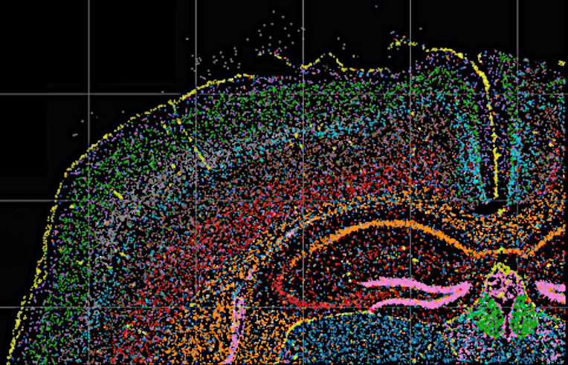
IMAGE 10
Recognition of frozen mouse brain cell images with deep learning model
SID: 500462616 | 500177868 | 500273300 510014087 | 510407902 | 490065813

Slide 2
Core Research Question
BACKGROUND
01
02
Which model best classifies clusters based on a larger number of clusters?
1. How to improve the accuracy?
2. How to make our models better generalized?

Slide 3
Complete Experimental Procedure
BACKGROUND
01
02
03
04
PREPARE
PREPARE
PREPARE
RESEARCH
Collect the data
Prepare the data
Create base model
Optimize the model
05
06
07
08
RESEARCH
RESEARCH
RSEARCH
RESULTS
Change the split method to 60:20:20
Compare random with stratified split
Reduce the number of clusters
Experimental result and analysis

Slide 4
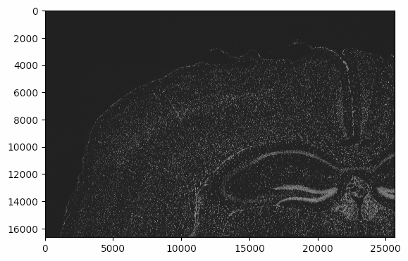
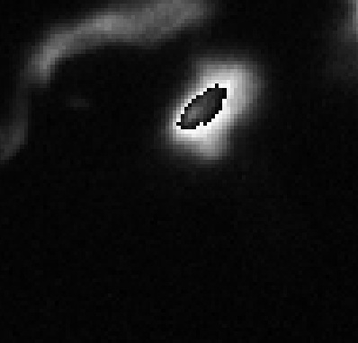
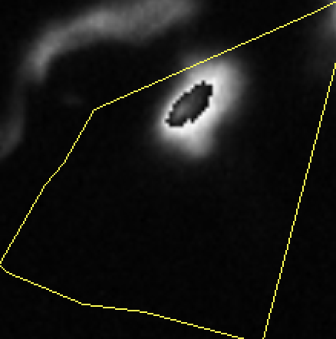
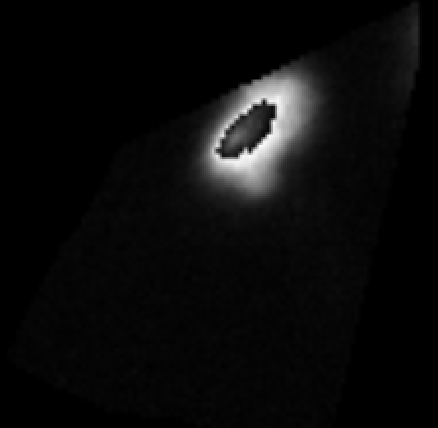
Data collection & Pre-processed
EDA
01
02
03
04
Original Image
Cell Image
Process Image
Output Image
Fresh frozen mouse brain image
Unprocessed cell morphology image
Mask and resize the images
Clean images with mask and same size

Slide 5
Process of Deep Learning Model
METHODOLOGY
Vision Transformers
Load Images
01
Effectively capture long-range dependencies
Read images from the cleaned dataset
ResNet150
02
Train-Val-Test Split
Effectively handle complex image recognition tasks
Organized into training, validation, and test sets
03
VIT Model & ResNet150 model
Train the model using train and validation sets
04
Classification
Evaluate the best model on the test dataset

Slide 6
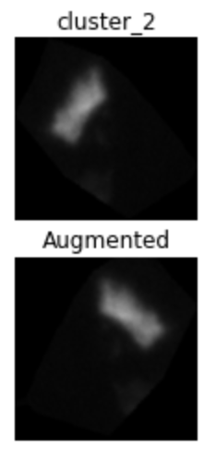
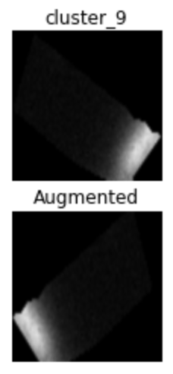
Model Optimization Example
METHODOLOGY
Data augmentation
Example of data augmentation
Parameter | Description
zoom_range | Zoom in or out of the image by up to 10%
horizontal_flip | Flip the image horizontally (like a mirror)
fill_mode | Fill empty areas created by the changes with the nearest color
Adapt learning rate
Parameter | Description
initial_learning_rate | The starting learning rate is 0.0001
decay_steps | Learning rate is updated every 10,000 steps
decay_rate | Each time the learning rate is updated, it is multiplied by 0.9

Slide 7
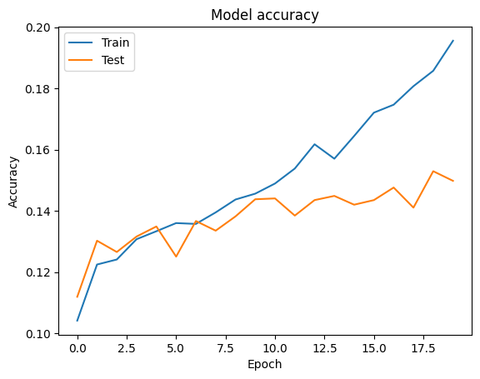
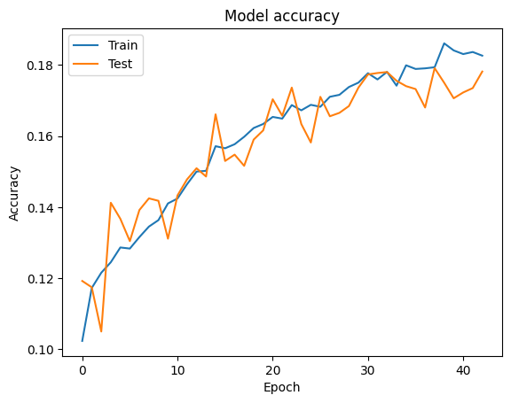
Comparison of before and after optimization model
RESULTS
Base model
Optimised model
Test accuracy: 0.14983
Test accuracy: 0.17908

Slide 8
Compare full random & stratified split method
METHODOLOGY
Full Random Splitting
Stratified Splitting

Slide 9
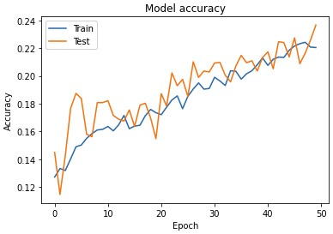
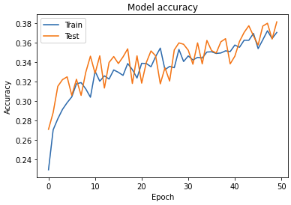
Reduce the number of clusters
METHODOLOGY
01
14 Clusters
Top-performing clusters from confusion matrix comprising 28 clusters
Test accuracy: 0.22011
Exploring the performance of our model with fewer clusters
02
7 Clusters
Most pronounced separation clusters on the UMAP projection of cells
Test accuracy: 0.36468

Slide 10

Shiny App Demo
SHINY APP

Slide 11
Summary
CONCLUSION
Model | Test Accuracy
Vit random 7 | 37.49%
Vit random 14 | 22.47%
Vit random 28 | 18.22%
Vit stratified 7 | 36.47%
Vit stratified 14 | 22.01%
Vit stratified 28 | 17.91%
RestNet random 7 | 42.21%
RestNet random 14 | 25.96%
RestNet random 28 | 18.96%
ResNet stratified 7 | 38.28%
ResNet stratified 14 | 19.76%
ResNet stratified 28 | 15.95%

Slide 12
Limitation & Future work
CONCLUSION
01 | Limitation
 | Valid only for frozen mouse brain cell images
01 | Future Work
 | Applying our model to cell images of other animals
02 | Limitation
 | Online platform GPU limitations
02 | Future Work
 | Use more complex models with a better GPU

Slide 13
Reference List
CONCLUSION
A. Parvaiz, M. A. Khalid, R. Zafar, H. Ameer, M. Ali, and M. M. Fraz. "Vision Transformers in Medical Computer Vision -- A Contemplative Retrospection." arXiv preprint arXiv:2203.15269, March 2022.
M. Merrillees and L. Du, "Stratified Sampling for Extreme Multi-Label Data," eprint arXiv:2103.03494, March 2021.

Slide 14
Division of work in the group for the presentation
CONCLUSION
Presentation + Q&A
Shiny App Video + Q&A
Slides making
Guan, Qiuze, Ruby
Xuwei, Hanzhang, Yuni
Guan

Slide 15
Thank you!

